Slide 1
Polymer Classification Using Machine Learning
EM/ISE 538
Mike Keating

Slide 2
Background Polymer Mechanical Testing & Material Selection
Design
Design Criteria
Data
Gather data on candidate materials to compare.
Mechanical data can be provided by supplier or performed by testing lab.
Selection
Select material based that meets the optimum criteria.
Often a balance that varies from project to project.
Physical
Mechanical
Regulatory
Cost
Notes:
Background Overview
Mechanical Testing & Material Selection:
In engineering and product development, selecting the right material is critical to ensure performance, safety, and cost-effectiveness.
Mechanical testing—such as measuring tensile strength, modulus, impact resistance, and elongation—provides quantitative data on how materials behave under different loads and conditions. These properties are essential for comparing materials and making informed choices for specific applications.
Ashby Plots:
Ashby plots are powerful visualization tools that map material properties against each other (e.g., strength vs. density). They help engineers quickly identify which materials meet the requirements for a given application by visualizing trade-offs and performance envelopes. For polymers, Ashby plots can reveal clusters and trends that correspond to different polymer classes.

Slide 3
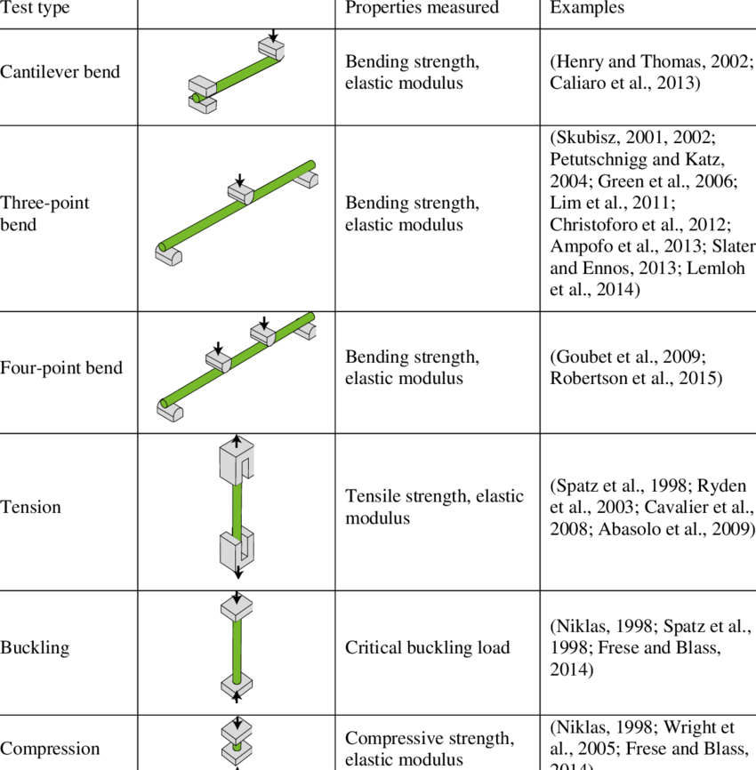
Background Polymer Mechanical Testing & Material Selection
Data
Gather data on candidate materials to compare.
Mechanical data can be provided by supplier or performed by testing lab.
Mechanical test types typically used on plant stems. Example references... | Download Table

Slide 4
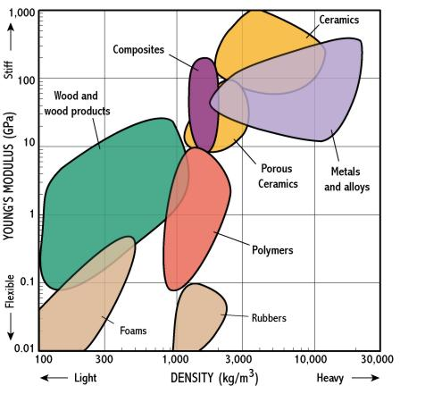
Background Material Selection & Classification
Materials can be placed in broad classes based on composition and properties.
Materials can be further divided into subclasses.
Polymers are generally classified by their polymer family (composition of repeat unit).
Ashby Plot
http://www-g.eng.cam.ac.uk/125/noflash/now/mfs/tutorial/non_IE/charts.html

Slide 5
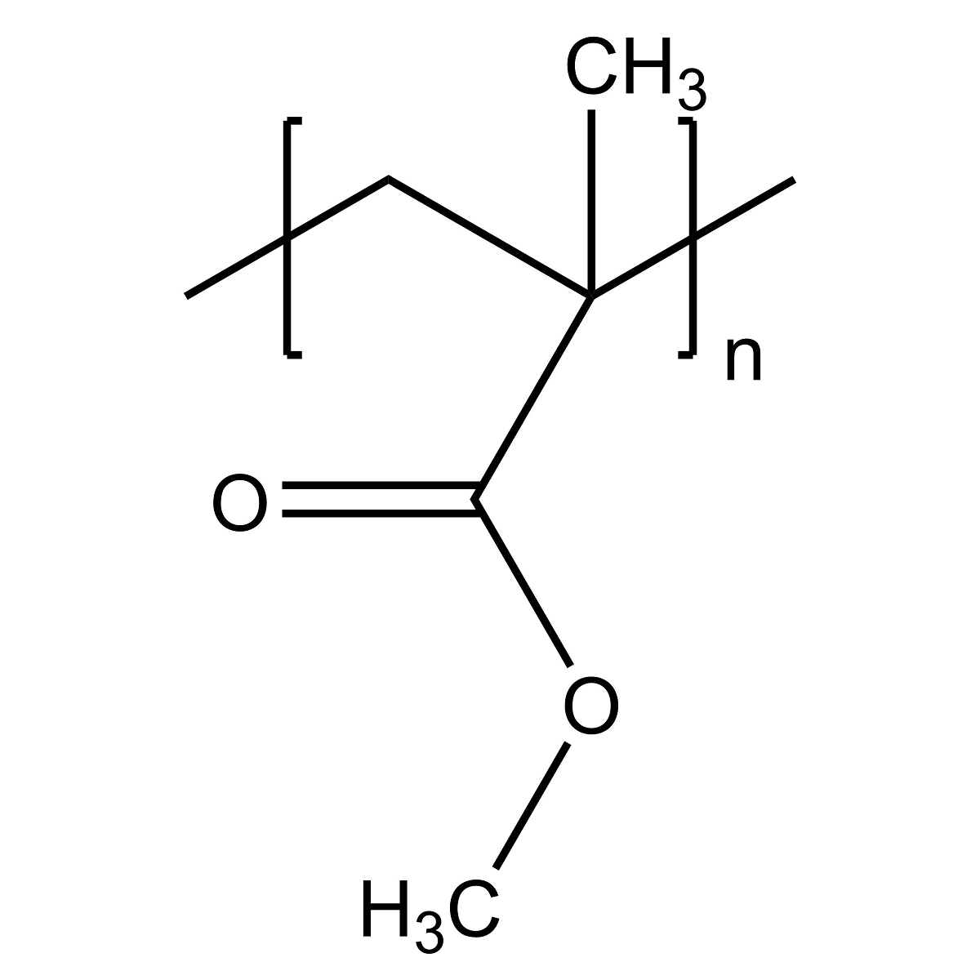
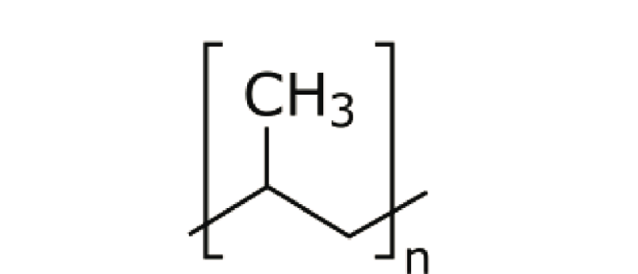
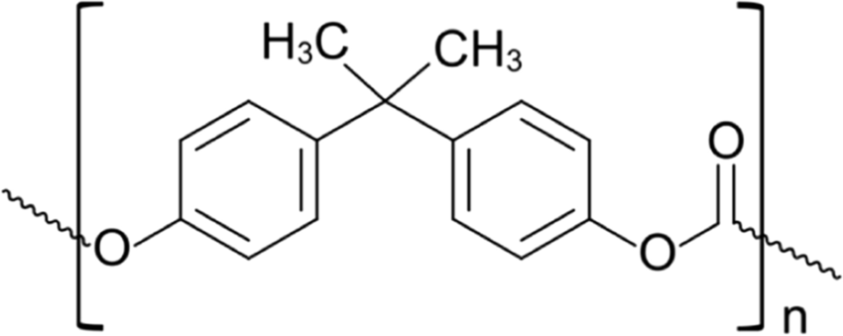
Background Polymer Subclasses
Polymers are generally classified by their polymer family (composition of repeat unit).
Poly(methyl methacrylate) [PMMA]
Polycarbonate
[PC]
Polypropylene
[PP]
“Less Stiff”
Lower Modulus
“More Stiff”
Higher Modulus

Slide 6
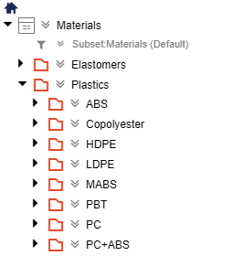
Problem Statement
Polymer subclasses offer a quick way to reference polymers with similar physical and mechanical properties.
Occasionally in R&D, the composition or subclass of a polymeric material may be unknown.
There is still a desire to group unknown materials together, particularly in a material database.
Manually determining subclass can be tedious or impractical.
There is a need for an automated assignment of polymer subclass for the purpose of database organization.

Slide 7
Objectives
Create a ML model that can predict polymer subclass based on mechanical data.
Model will be trained to predict on a small subset of polymer classes, with a target of at least 5 unique classes.
Achieve at least 80% classification accuracy

Slide 8

Data Source
UL Prospector
Database containing technical data of over 100,000 polymeric materials.
Data is primarily provided by the material supplier.
Access is free with registration.

Slide 9
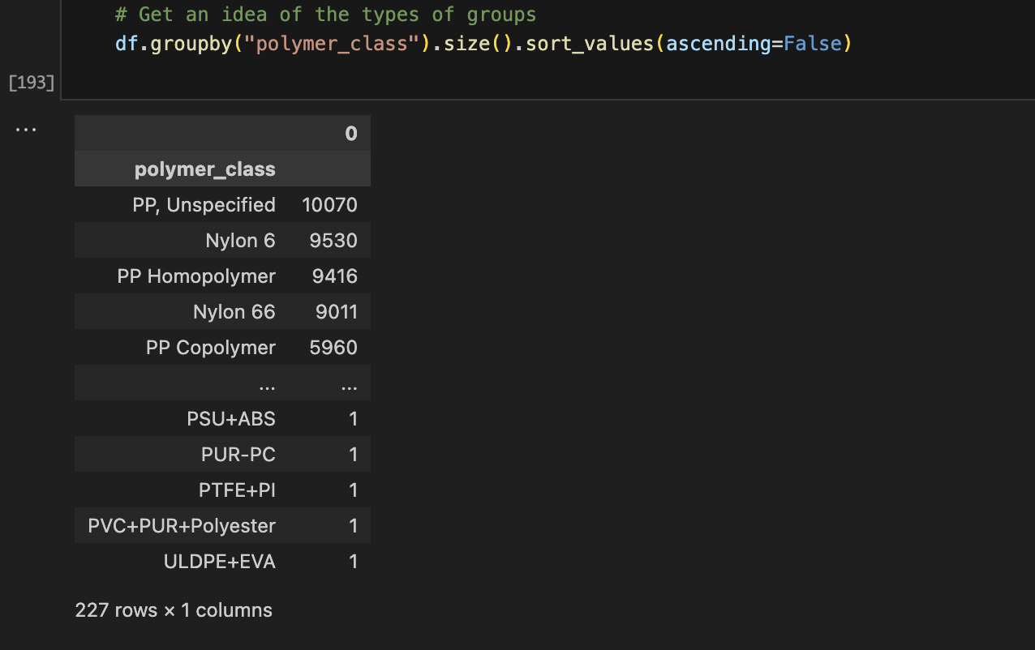
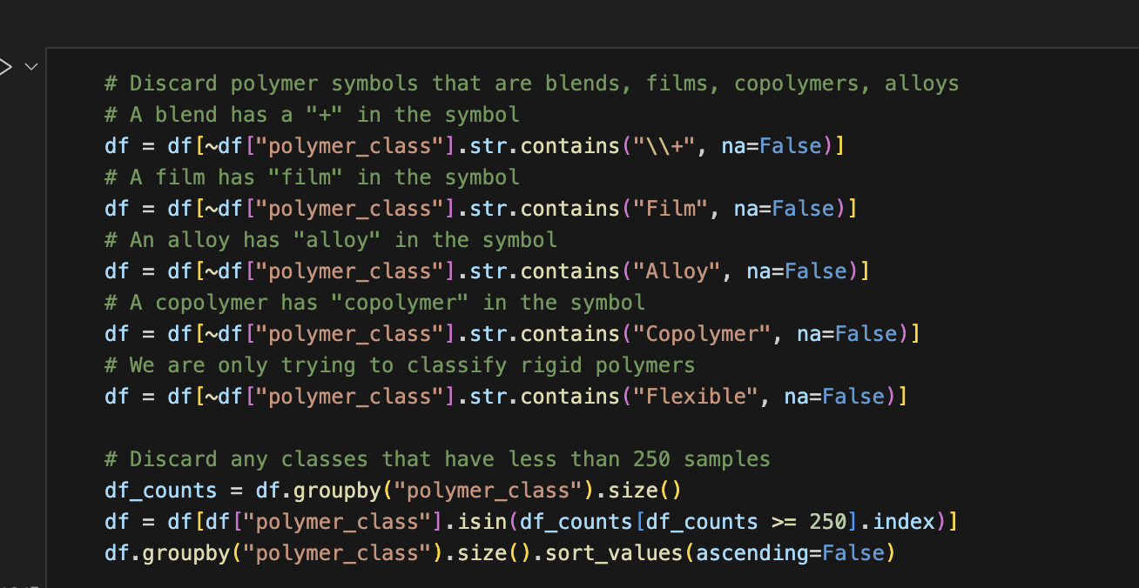
Data Preparation
Database was queried with a handful of polymer symbols (PP, ABS, etc) and a .csv file was generated for each
Raw data included blends, alloys, and composites and required extensive cleaning.

Slide 10
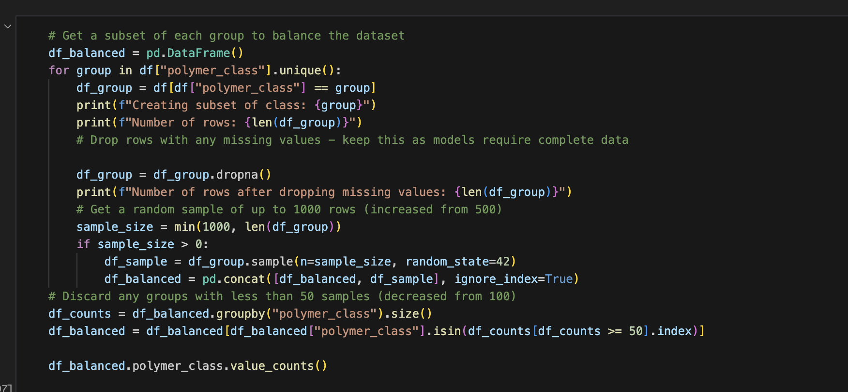
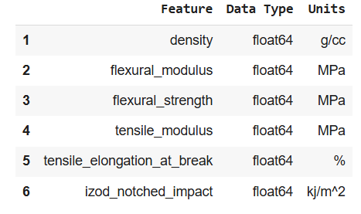
Data Preparation
Many entries missing one or more feature values.
Large potential for class imbalance if simply discarding NaN values.
Subsets with complete feature data were created from several hand selected polymer classes.
Only features with sufficient available data were selected.
Final Dataset Features

Slide 11
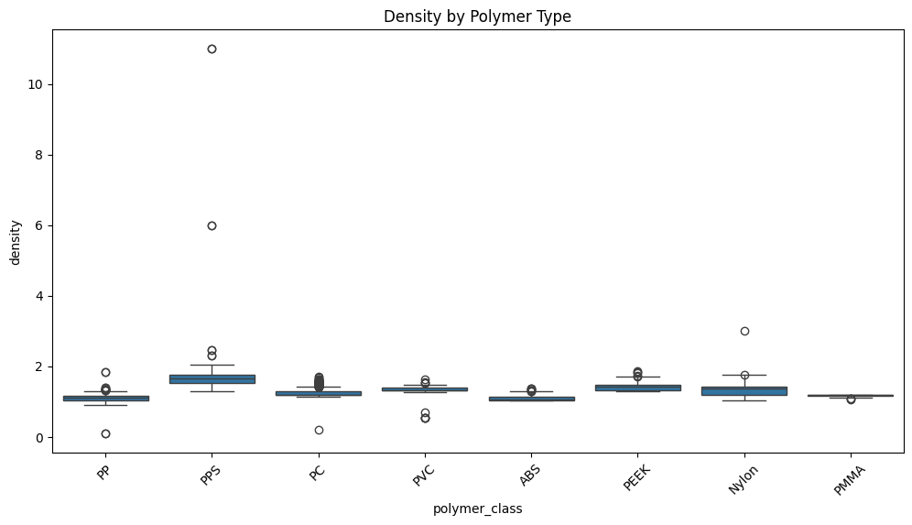
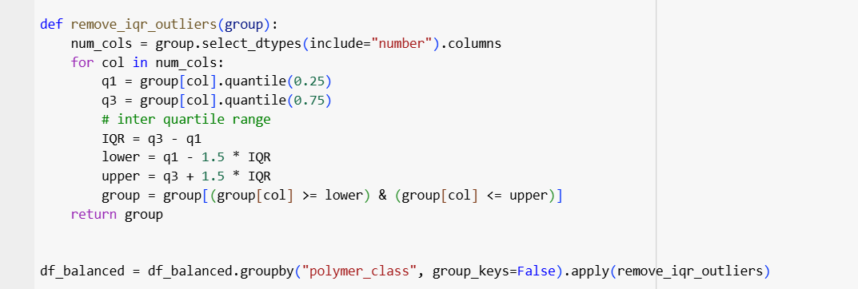
Data Preparation Handle Outliers
Density above 10 g/cc would be more dense than steel!
Some features had extreme outliers that suggest an issue with the source data integrity.
Data was trimmed to only include the IQR for each group.
We mask some potentially real variability, but preserve the core trends per group.

Slide 12
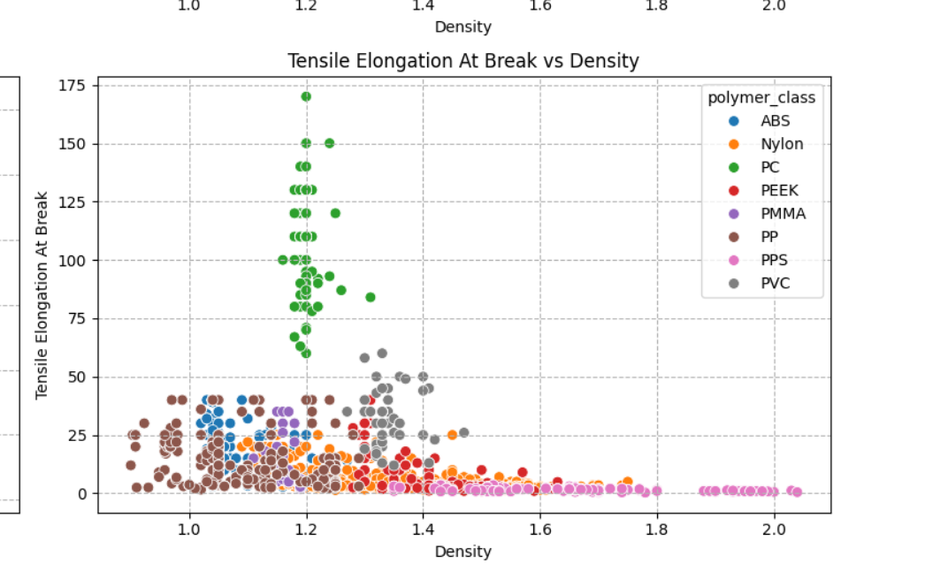
EDA: Ashby Plots

Slide 13
ML Methods
Logistic Regression (log_reg)
K-Nearest Neighbors (knn)
Random Forest (rf)
XGBoost (xgb)

Slide 14
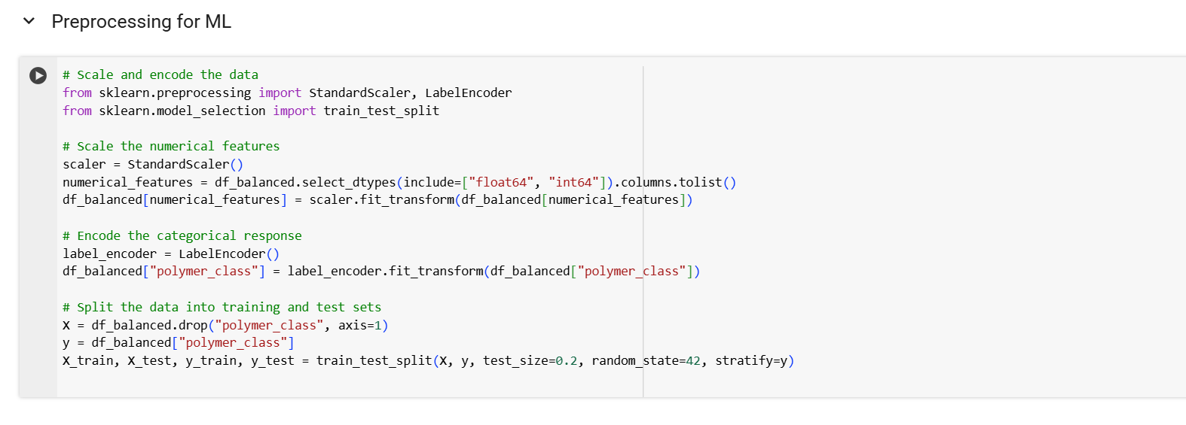
ML Preprocessing

Slide 15
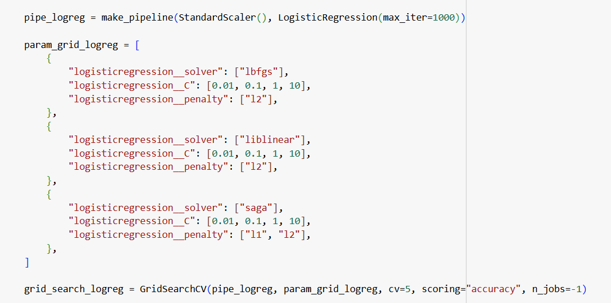

Logistic Regression: Tuning

Slide 16
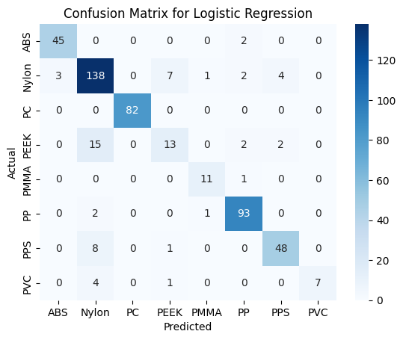
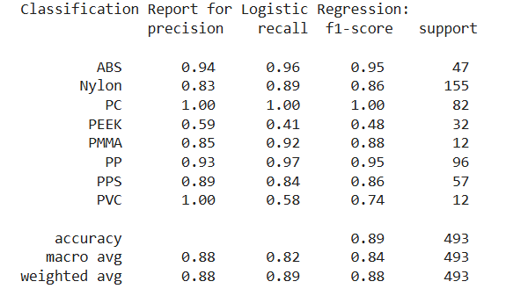
Logistic Regression: Performance

Slide 17
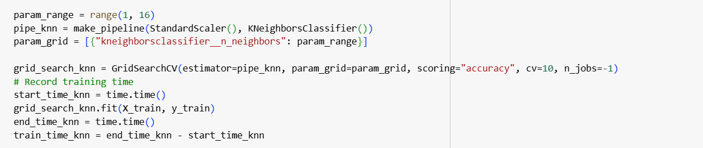
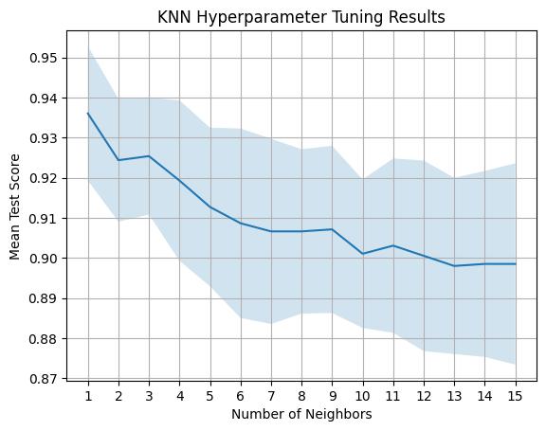
K-Nearest Neighbors: Tuning
Optimal k value of 1 in CV folds may suggest overfitting, and may be sensitive to noise

Slide 18
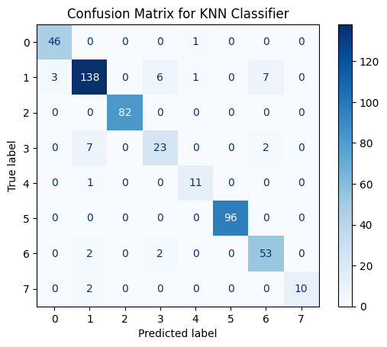
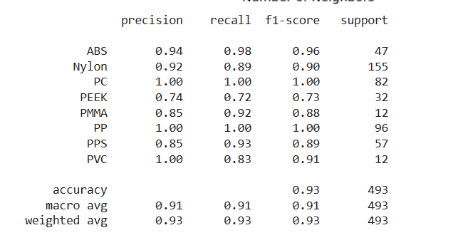
K-Nearest Neighbors: Performance

Slide 19
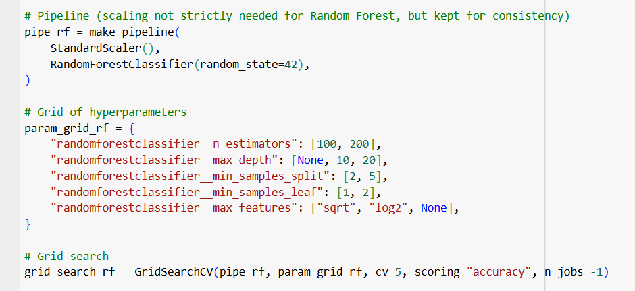
Random Forest: Tuning

Slide 20
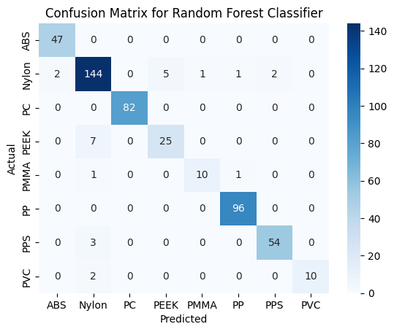
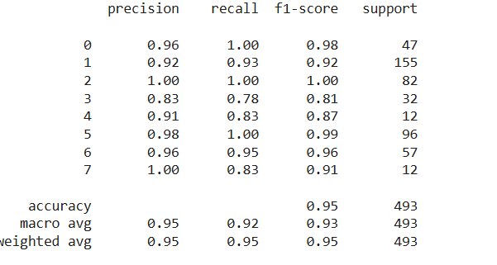
Random Forest: Performance

Slide 21
XGBoost: Tuning

Slide 22
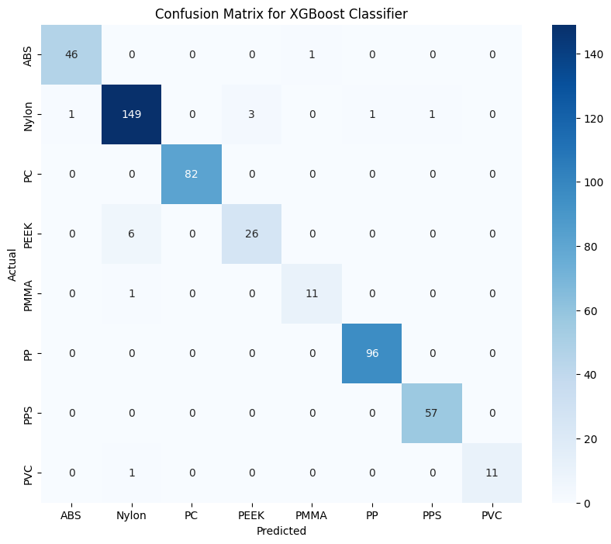
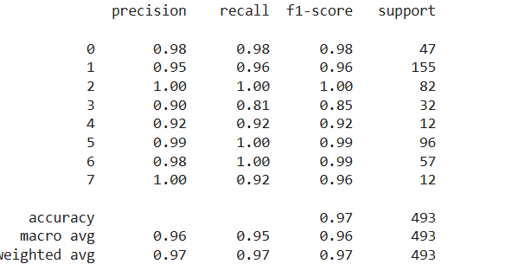
XGBoost: Performance

Slide 23
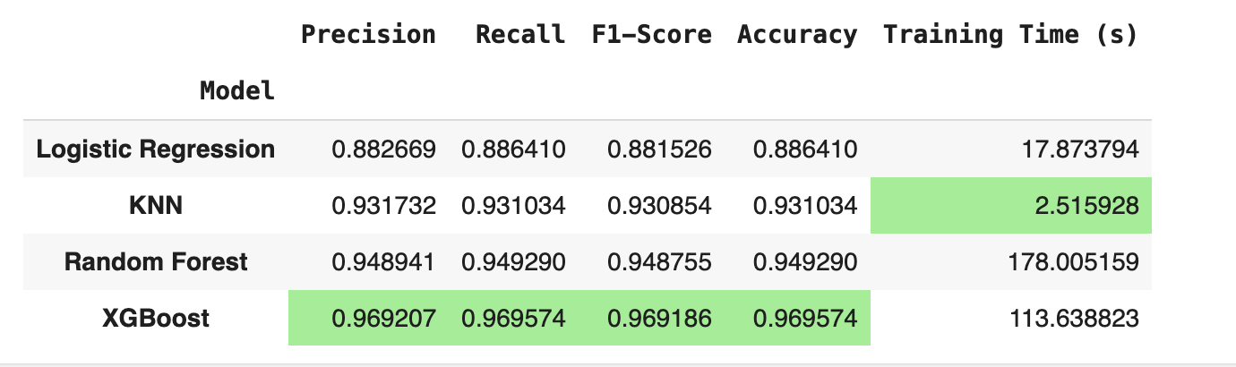
Model Results Summary

Slide 24
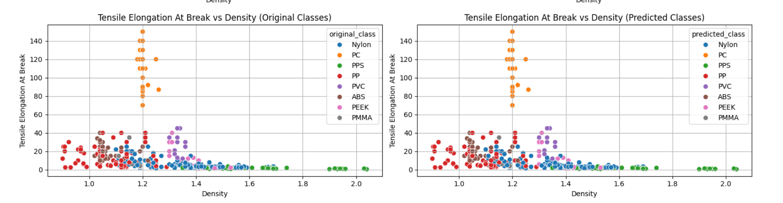
XGBoost: Visualize Predictions

Slide 25
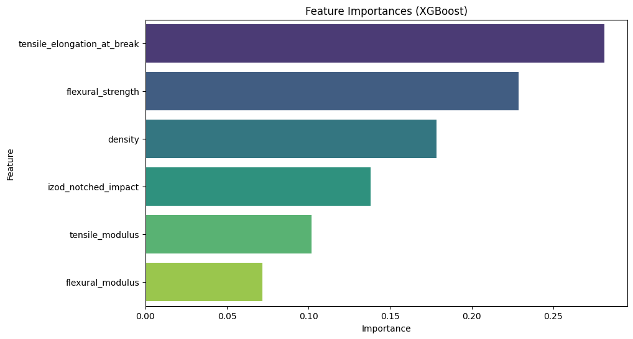
XGBoost: Feature Importance

Slide 26
Conclusion
XGBoost gave us exceptional performance at the expense of a slightly sluggish training time.
Future Work:
Determine if we can predict class with fewer features.
Impute missing values in the dataset

